Slide 1
MVC pattern
ALLPPT.com _ Free PowerPoint Templates, Diagrams and Charts

Slide 2
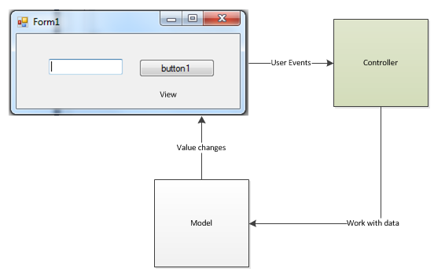
MVC pattern

Slide 3
MVC pattern
The Model - This should take care of all the operations which deal with the data required (in other words the business logic) for the application, which is implementing the MVC model from now onwards will be referred to as by the MVC application. The operations can mean reading, writing data into the database, getting information from remote machines via network, time consuming operations etc. The model should also inform the view about any changes to the data happening in the background.
The View - This component takes care of presenting the data to the user. With respect to the context of this article, i.e., WinForms, the view class will be tied around with the Form which will be shown to the user.
The Controller - This is the center and important component of the MVC pattern as it ties the Model and View together. The Model which manipulates the data and the View which presents the data to the user does not know the existence of each other or they interact directly with each other. It is the controller which acts as an intermediary and ties them together. For example, the controller takes the input from the user such as a button click and informs the model to take appropriate action, if there should be an action that needs to be initiated to manipulate the project data.

